Slide 1

Perl language
hoeseng

Slide 2
Nextest perl script template

Slide 3
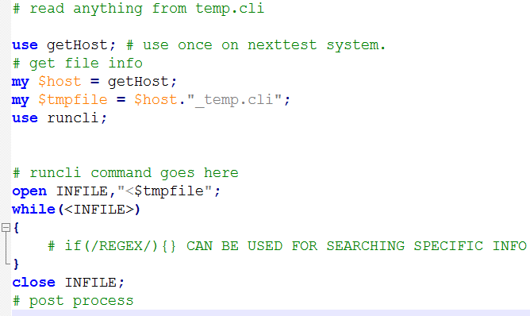
Next

Slide 4
← Comment (Ctrl + Q)
- has no effect on the code
- Comes in handy for future reference
Next

Slide 5
use - To latch in module/”library” into current script
Here the getHost.pm is loaded
Next

Slide 6
- Retrieve the nextest station detail
Will return something like :
mav2pt-0014
Next

Slide 7
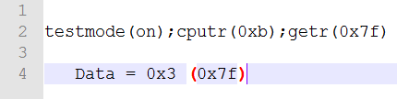
Define the tmpfile as the nextest cli temporary file
Contains all the text as displayed on Nextest CLI
mav2pt-0057_temp.cli
Next

Slide 8
Enable input from perl script as nextest cli command
e.g. runcli(“set(vcc,3.3)”)
Next

Slide 9
← makes the file ready for reading from INFILE
Next

Slide 10
← Working with the file
Next

Slide 11
← Close the file after done reading it
Next

Slide 12
Regex / Regular Expression
search pattern, mainly used for pattern matching
E.g. :
"Hello World" =~ /World/; # matches
Back
Next

Slide 13
Regex / Regular Expression
*
.
|
( )
^
Others
Back
Next

Slide 14
Regex / Regular Expression
zero or more of the previous characters should be matched
baa*
ba , baa , baaa , …
*
.
|
( )
^
* | Match 0 or more times
+ | Match 1 or more times
? | Match 1 or 0 times
{n} | Match exactly n times
{n,} | Match at least n times
{n,m} | Match at least n but not more than m times
Others
Back
Next

Slide 15
Regex / Regular Expression
Match any valid character
a.c
abc , acc , amc , …
*
.
|
( )
^
Others
Back
Next

Slide 16
Regex / Regular Expression
equivalent to an "or" in regular expression
abc|def will match any string that contains either abc or def
*
.
|
( )
^
Others
Back
Next

Slide 17
Regex / Regular Expression
group things together
xx(abc|def)*xx
contains abc or def, zero or more times
xxabcxx, xxabcabcxx, xxdefxx, xxxx, xxabcdefxx, …
*
.
|
( )
^
Others
Back
Next

Slide 18
Regex / Regular Expression
apply the regular expression from a defined point
^aa*
matches strings that start with one or more a's
abc , aac , aa , a , …
Use $ if want to anchor at the end, e.g. abc$
*
.
|
( )
^
Others
Back
Next

Slide 19
Regex / Regular Expression
(0|1|2|3|4|5) ⬅➔ [0-5]
/i ➔ case-insensitive matching
m/// ➔ match operator
s/// ➔ substiture operator
\ ➔ special character, such as [ , ] , “ , ….
\d ➔ match digits
\s ➔ match whitespaces
\w ➔ match any single character classified as
“word” character (alphanumeric or “_”)
*
.
|
( )
^
Others
Back
Next

Slide 20
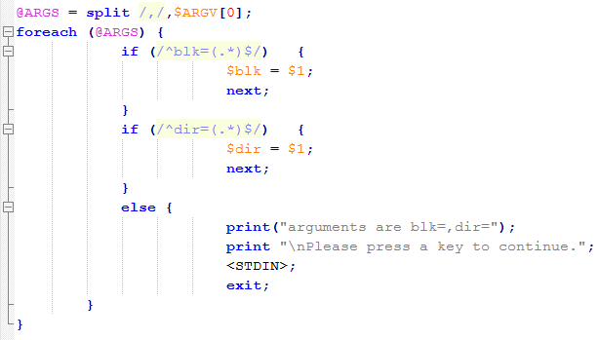
Back
Next

Slide 21
$ (String)
@ (Array)
split $ARGV by “,” into array ARGS
e.g. :
$ARGV[0] = “2,248,54,83”
@ARGS = (“2”, “248”, “54”, “83”)
Back
Next

Slide 22
This will match anything that start with “blk=” and store it in $blk
$1 means the value return from first regex matchup
Back
Next

Slide 23
This will match anything that start with “dir=” and store it in $dir
Contains the directory/folder name
Back
Next

Slide 24
If no matches found for both regex, then this command will be executed
print is output on perl ui, while <STDIN> means input from keyboard
Back
Next

Slide 25
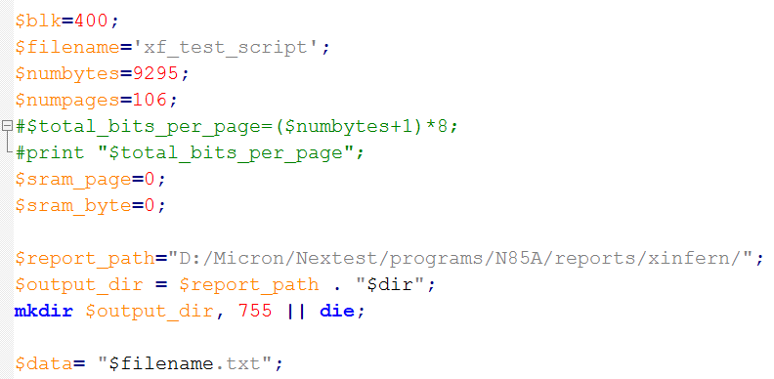
Back
Next

Slide 26
Defining for each string/”variable”
Back
Next

Slide 27
← Hashed out, instead of deleting them, easier to revert changes in the future
Back
Next

Slide 28
Need to change the $report_path to folder of desired, $output_dir will store the complete dir of the report file
Back
Next

Slide 29
Create the directory using $output_dir,
mask value 755 indicates full permission granted to the file
|| die - If the script failed to create the directory, the script will terminate at once
Back
Next

Slide 30
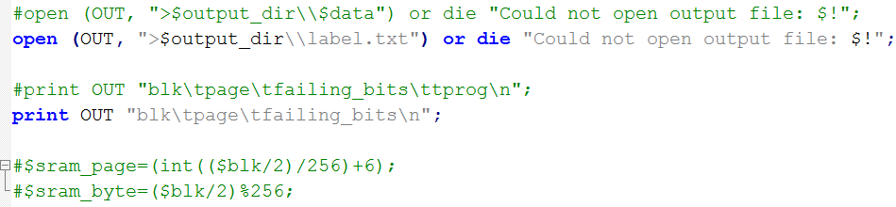
Back
Next

Slide 31
Try to open label.txt and name “filehandle” as OUT,
failing in doing so will terminate the script and prompt “Could not open output file: $!”
Back
Next

Slide 32
“Print” in both OUT (filehandle, this case is the same as label.txt) and also perl command prompt screen
\t - tab
\n - newline
Expected outcome
blk page failing_bits
Back
Next

Slide 33
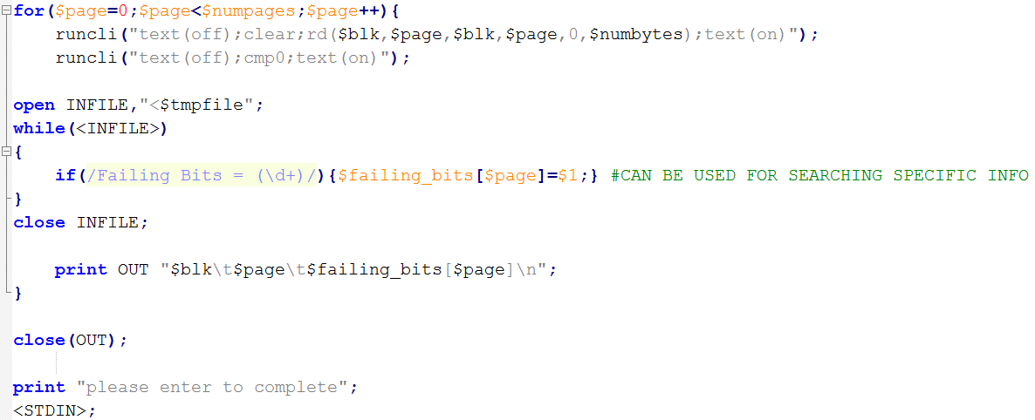
Back
Next

Slide 34
For loop, will not stop until condition is met
for (initial condition ; target/comparison ; execute if false)
$page (initially 0) will increment by one for each loop until it reaches $numpages
Back
Next

Slide 35
Nextest cli process (indicated by “runcli ” )
Turn off text interface (to prevent these command from displaying in nextest cli)
Execute clear;rd($blk,$page,$blk,$page,0,$numbytes) in nextest
Turn on text interface (to display the rd output)
Turn off text interface
Execute cmp0
Turn on text interface (to display cmp0 output)
*The temporary file is overwritten after each call to runcli(), so any desired output
should be checked immediately afterward.
Back
Next

Slide 36
a
This is one of the most important section which we used to crunch the data we obtain on bench
Basically perform regex matching, then output the captured pattern and process it in desired format
Back
Next

Slide 37
Close OUT (label.txt) after done processing it
Back
Next

Slide 38
Display “please enter to complete” on perl gui
<STDIN> - Capture keyboard input and “enter” to proceed to next line
At here, it ends the script, because there is no more line afterward
Back
Next

Slide 39
Try to match the text in (hostname)_temp.cli
\d+ → with one or more digits
so will match Failing Bits = 100 and so on
Then it will store the value return, here 100 in $failing_bits, which is an array corresponding to the page number. ($failing_bits[3])
After that, it will close the temp file and print out the data in both OUT and gui in such format :
3 100
_
Back

Slide 40
Numerical Operators
Operator | Associativity | Description | Example
** | right | exponentiation | 2**2**3 interpreted as 2^(2^3) = 256
*, /, % | left | multiplication, division, modulus | 5*4/2%3 interpreted as [(5*4)/2]%3 = 1
+, - | left | addition, subtraction | 8+4+3 interpreted as (8+4)+3 = 15
Back
Next

Slide 41
Comparison Operators
Operation | Numeric | Returns
less than | < | 1 if $left is less than $right
less than or equal to | <= | 1 if $left is less than or equal to $right
greater than | > | 1 if $left is greater than $right
greater than or equal to | >= | 1 if $left is greater than or equal to $right
equal to | == | 1 if $left is the same as $right
not equal to | != | 1 if $left is not the same as $right
compare | <=> | -1 if $left is less than $right 0 if $left is equal to $right 1 if $left is greater than $right
Back
Next

Slide 42
Control Structure
if/else if (expression) { Expression_True_Statement; } elsif (another_expression) { Expression_Elseif_Statement; } else { Else_Statement; } | while or until while (expression) { While_Statement; While_Statement; While_Statement; }
for for(Initial_Statement; expression; Increment_Statement) { For_Statement; For_Statement; For_Statement; } | do/while do { DoWhile_Statement; DoWhile_Statement; DoWhile_Statement; } while (expression);
foreach my @collection = qw/hat shoes shirts shorts/; foreach my $item (@collection) { print "$item\n"; }
Back
Next

Slide 43
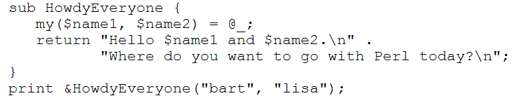
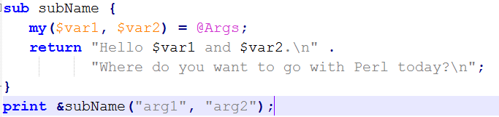
Subroutine
Several ways to concatenate string: $foo = “abc”, $bar = “def”
$foo = $foo . $bar
$foo. = $bar
$foo = join “abc”, “def”
$foo = join $foo, $def
$foo = “$foo$bar”
*Variable defined inside subroutine only valid within the block
Back
Next

Slide 44
Extras
if(/Fuse ID = (.{17}):(.*)Checksum = (\w+).*/)
use TrimTool;
setbits($loop,'loop_spgm');
setbits(0x0,'trmp');
getbits();
bits – digital value, value – actual value (might be in accurate sometime)
3. % ← hash
my %table
$table{“a”}= ‘def’;
$table{“2.5”}=1.2;
keys %table → contains “a” 2.5
values %table → contains “def” 1.2
Back
Next

Slide 45
Index
Nextest script template
Sample script
Regex
Numerical Operators
Comparison Operators
Control Structure
Subroutine
Extras
Back
Next

Slide 46
Reference
template - I:\programs\n85a\scripts\xinfern\templates\read_temcli.pl
failbits script - I:\programs\n85a\scripts\xinfern\templates\ xf_failbits_all.pl
Picking Up Perl - http://www.linuxtopia.org/online_books/perl/pickingUpPerl.html
Back
Next

